Slide 1


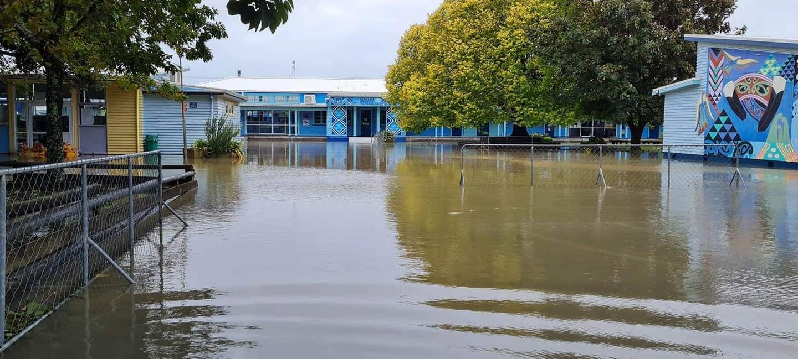
NUHAKA COMMUNITY EMERGENCY RESILIENCE PLAN AND 5-10 YEAR STRATEGY DRAFT

Slide 2
CONTENTS
SETTING THE SCENE
WHAT OUR COMMUNITY SAID
- Immediate Resilience Priorities
COMMENTS
WHAT OUR COMMUNITY WANT. 5-10 YEAR STRATEGY
- Social
- Cultural
- Economic
- Environment
- Infrastructure

Slide 3
SETTING THE SCENE
The purpose of this presentation is to provide the community with an update of the information collected from individuals within the community to support the development of our:
NUHAKA COMMUNITY EMERGENCY RESILIENCE PLAN
& 5-10 YEAR STRATEGY.
The presentation seeks endorsement from the community to support the immediate resilience priorities followed by your comments for the 5-10-year strategic plan.

Slide 4
WHAT OUR COMMUNITY SAID
IMMEDIATE RESILIENCE PRIORITIES
Establish a local Voluntary Disaster Management Steering Group
SUPPORT PARTNERS
Install a Star Link Service
Establish an Access to Emergency Accommodation protocols with Marae caretakers
Halt the erosion of the riverbank around the pylons at the Rakaipaaka Bridge
HB REGIONAL COUNCIL
Establish an official Nuhaka Emergency Command Centre on a neutral site
WAIROA DISTRICT COUNCIL
Provide emergency disaster training to local volunteers
Establish an Access to Emergency Hub protocols with Hub caretakers
Upgrade the internal drains throughout the village and the wetlands
Increase the numbers of Emergency Hubs – 1 in Morere and 1 in the Village
CIVIL DEFENCE
Develop Community Readiness Packages for each household
Prevent future external floodwaters from entering the village
Remove all slash from waterways, mulched and transported away.
COMMUNITY PARTNERSHIP GROUP
(CPG)
Design specific evacuation road maps for each evacuation hub.
Conduct simulated emergency evacuation procedures within Nuhaka district
TATAU TATAU o
TE WAIROA
Prevent further erosion of the Nuhaka Riverbank and all its Tributaries
Repair the erosion of the riverbank behind the Residence at 5 Te Kauwaha Street (URGENT)
Install an emergency generator to provide power to the Nuhaka community during disasters
TE IWI O NGATI RAKAIPAAKA

Slide 5
COMMENTS
Number of Whanau Whanui contributed to date is 76 from a population of 198 (official Statistics from 2018 census)
We would like to achieve a Target of 120 people contributing to achieve a 61% ratio of our population.
We would like more Rangatahi to contribute.
We would like more farmers to contribute.
Completion date for contributions is 20 March 2024.
Final Plan completed 30 March 2024

Slide 6
WHAT OUR COMMUNITY WANT
SOCIAL DEVELOPMENT
5-10 YEAR STRATEGY
TR
HEALTH
EDUCATION
HOUSING
COMMUNITY
ATTRACTION
RECREATION
SAFE COMMUNITY
Establish a Community Health clinic in Nuhaka
Rebuild the school on existing site
Build more homes
Museum & Public Library & Cinema
Build a Childrens Playground
Neighbourhood
Watch. Implement Home Guard Model
Support Traditional Rongo Clinics
Embrace cultural significance of the whenua
Speed up Resource compliance approvals
Build a Community Centre
Install a Picnic area at the bridge
Request Daily Police Presence
Promote Healthy food initiatives
Rebuild with future generations in mind
Build a Kaumatua Housing complex
Establish a community Garden
Develop & host more Kaumatua activity
No more drugs in Nuhaka
Reduce paperwork to access Maori multi owned Land
Create a thriving sustainable community market
Develop an I.T training program to upskill Kaumatua
Annual meet the neighbour event
Change the status to an Area School (Kohanga to Tertiary)
Prefer not to demolish current buildings but repurpose
Lead Te Maara St Housing Development
Install a Community Kai Cupboard at the General Store
Build a Community Swimming Pool
Establish a two-weekly newsletter
Challenge Ministry for resources
Build Papa Kainga homes
Build a Community Sports Complex
Establish Community Walking Tracks
Establish a Maori Wardens Network for Nuhaka

Slide 7
WHAT OUR COMMUNITY WANT
CULTURAL
5-10 YEAR STRATEGY
MARAE
MATAURANGA
TIKANGA
MAORI ASSETS
Introduce Marae cultural Tourism Initiatives
Access funding to assist with Marae Renovations
Install a demonstration Pod on a Marae for public viewing
Protect the Guardians of Historical Acknowledge
Increase awareness and use of Te Reo in the community
Make access to multi owned land to build homes less onerous
Implement 70km speed restrictions in front of all Marae
Protect our flora/fauna within Marae surrounds
Funding to upskill our Marae governance members
Protect & promote cultural sites of significance
Promote Kapa Haka and waiata
Establish a Rakaipaaka Radio Station
Develop a Marae based Carving Kura
Establish a repository for historical Taonga
Marae used as Evacuation sites to be compensated
Protect Tikanga Values
Funding to support annual whakapapa wananga
Turning lanes at the entrance to Marae driveways
Promote and encourage Unity throughout the wider community
Establish a community Urupa maintenance program
Protect our Awa & Monitor water quality
Establish a database of all Tipuna in our Nuhaka Urupa
Establish small cottage industry businesses
Develop & promote community games night at the Marae
Replace roadside drains in front of marae with culverts
Encourage community participation
Facilitate Karakia courses
Develop a visual slideshow of our community & promote on mainstream Tourist sites
Marae designated as Evacuation sites to be provided with separate larger power generators
Cross pollinate cultures within the community

Slide 8
WHAT OUR COMMUNITY WANT
ECONOMIC
5 -10 YEAR STRATEGY
TOURISM
MORERE
GROW BUSINESS
ENTERPRISES
EMPLOYMENT
TRAINING
FOOD PRODUCERS
Marae Cultural Experiences
Kapa Haka performances
Return Morere to Ngati Rangi whanau
Establish a Business Round Table for Nuhaka
Create more employment in forestry and agriculture
Establish a Flight School Training Centre
Increase our current food production options
Mangaone Caves Tours
Establish a Morere/Nuhaka
Retail sector
Establish a Multi- Media Complex in Nuhaka
Provide opportunities for Rangatahi employment
Establish a Learn to be a Contractor Training Centre for Rangatahi
Grow more organic produce
Implement Tourism initiatives aligned to the environment
Relocate Ngati Rakaipaaka head office to Morere
Establish a fully serviced Garage in Nuhaka
Establish a Niche Simulator Training Centre
Grow more fruit and vegetable crops
Market Morere Hot Springs on Tourism Platforms
Establish a conference centre in Morere
Introduce fast-food outlets (KFC) (McDonalds)
Collaborate with local corporations and Farmers to create cadetships
Increase support to our local Farmers affected by disasters
Establish a caravan park in Morere
Establish a Tourism Centre in Morere
Build a 20 Unit Motel in Nuhaka or Morere
Develop a Rangatahi outward bound Institute at Morere
Facilitate workshops for preserving food
Establish Moumoukai Tours

Slide 9
WHAT OUR COMMUNITY WANT
ENVIRONMENT
5-10 YEAR STRATEGY
RIVERS & STREAMS
NGAHERE
WETLANDS
FORESTRY
AGRICULTURE & HORTICULTURE
SUSTAINABILITY
Plant more natives along the rivers and streams
Build our own local native plants nursery
Increase our wetlands around Nuhaka
Introduce a bio charcoal using forestry slash
Provide support to our farmers environmental protection projects
Employ a Community Environmental Monitoring Coordinator
Remove slash & debris stacked along all the riverbanks
Establish a green waste depot in Nuhaka
Clean and protect our current wetlands
Apply a forestry clear felling restrictions and impose policy for slash removal
Provide support to our Horticulture environmental protection projects
Establish a Energy Resource Centre for Nuhaka
Upgrade Tununui Stream to prevent further erosion
Erect walkways around the village wetlands
Build a free community water supply system
Remove all exotic trees and plant from our river environs
Construct spillway outlets to prevent flooding of homes around the wetlands in the village

Slide 10
WHAT OUR COMMUNITY WANT
INFRSTRUCTURE
5 -10 YEAR STRATEGY
ROADS
FOOTPATHS
BRIDGES
DRAINS AND CULVERTS
Upgrade and seal Mangaone & Kokohu Roads
Introduce 70km speed limit at Marae frontages along SH2
Install footpaths along Nuhaka Opoutama Rd from Tai Street to the bridge (both sides)
Upgrade Nuhaka Bridge approaches (they have dropped below bridge)
Install Safety barriers for street drains deeper than 600m
Upgrade Blacks Beach Road
Install Engine Brakes signage on Nuhaka Opoutama Road Boundary
Install footpaths along Ngati Rangi Street from General Store to the Nuhaka Domain
Stop the erosion of the bank around the Rakaipaaka Bridge Pylons
Increase the size of the culverts under the Nuhaka Roundabout
Upgrade Tununui Road as alternative route to & from Mahia
Repair and reopen Nuhaka River Road
Reduce speed limit in front of Kohanga Reo on Nuhaka Opoutama Rd

Slide 11
THANKYOU TO PARTNERS
RED CROSS MINISTRY for ENVIRONMENT
HB REGIONAL COUNCIL MINISTRY of EDUCATION
WAIROA DISTRICT COUNCIL MINISTRY CONSERVATION (DOC)
MINISTRY SOCIAL DEVELOPMENT
KiwiRail
TE PUNI KOKIRI

